Slide 1

Development of machine learning models to process Electronic Health Records – Imputation Strategies
Week 15 Meeting, 6/2/2021

Slide 2
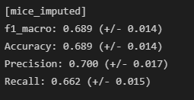
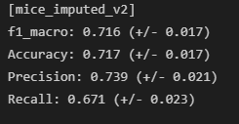
MICE Improved
Improved MICE by creating multiple imputations, then taking the mean of the imputed values
Round categorical values to closest category

Slide 3
Random forest results
[mice_imputed_v2]
f1_macro: 0.777 (+/- 0.007)
Accuracy: 0.777 (+/- 0.006)
Precision: 0.803 (+/- 0.013)
Recall: 0.743 (+/- 0.010)
[knn_imputed]
f1_macro: 0.765 (+/- 0.014)
Accuracy: 0.762 (+/- 0.015)
Precision: 0.786 (+/- 0.026)
Recall: 0.735 (+/- 0.013)
[midas_imputed]
f1_macro: 0.756 (+/- 0.008)
Accuracy: 0.765 (+/- 0.010)
Precision: 0.774 (+/- 0.010)
Recall: 0.727 (+/- 0.013)
[Mean-imputed]
f1_macro: 0.775 (+/- 0.016)
Accuracy: 0.770 (+/- 0.014)
Precision: 0.780 (+/- 0.019)
Recall: 0.763 (+/- 0.037)
[joint-imputed]
f1_macro: 0.766 (+/- 0.013)
Accuracy: 0.769 (+/- 0.012)
Precision: 0.781 (+/- 0.016)
Recall: 0.746 (+/- 0.020)
[mice_imputed]
f1_macro: 0.752 (+/- 0.012)
Accuracy: 0.747 (+/- 0.010)
Precision: 0.764 (+/- 0.012)
Recall: 0.709 (+/- 0.011)

Slide 4
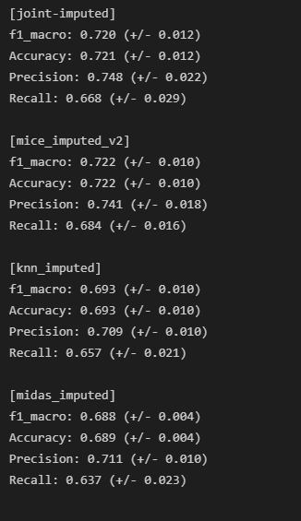
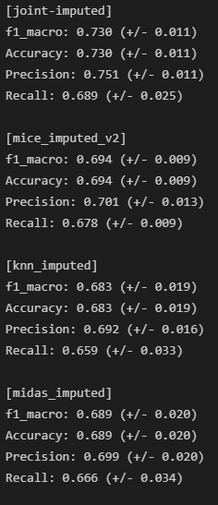
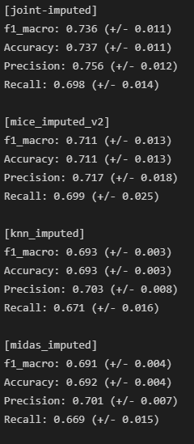
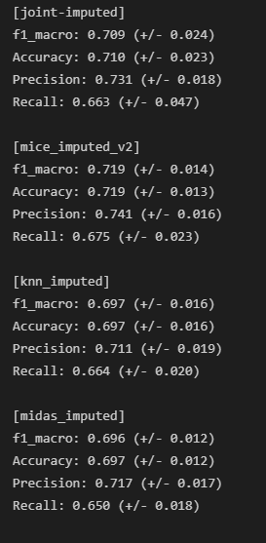
WITH OUTLIERS VS WITHOUT OUTLIERS (LOGISTIC REGRESSION)
Minmax scaling + rounding
+ One hot encoding
+ remove outliers
- One hot encoding

Slide 5
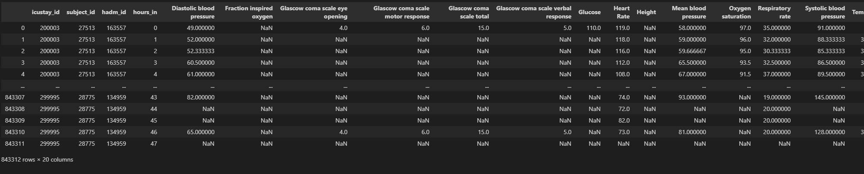

Slide 6
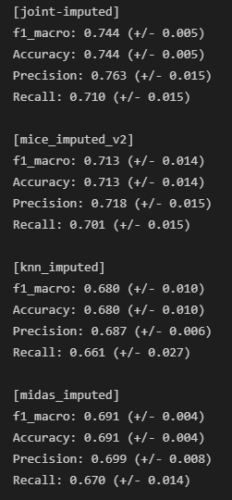
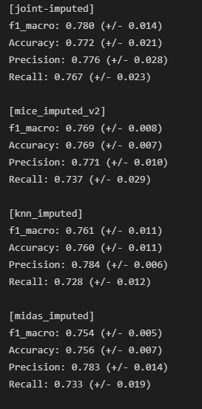
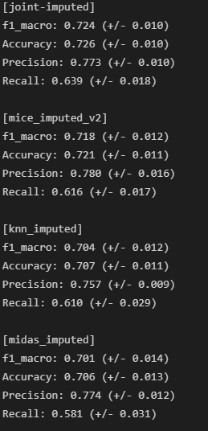
Between classification models (Minmax scaling + rounding + Outliers removed+ One hot encoding)
Logistic regression
Random Forest
svc

Slide 7
Trends found when optimizing
One hot encoding categorical feature gave worst results
Rounding categorical variables gave less accurate results

Slide 8
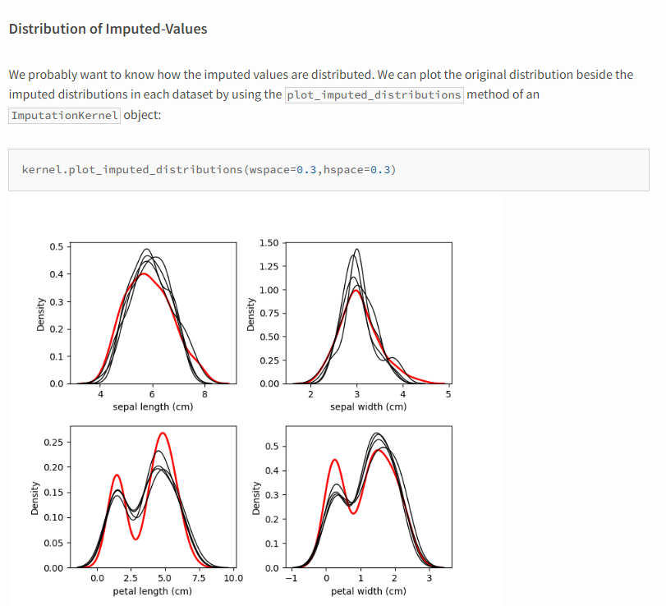
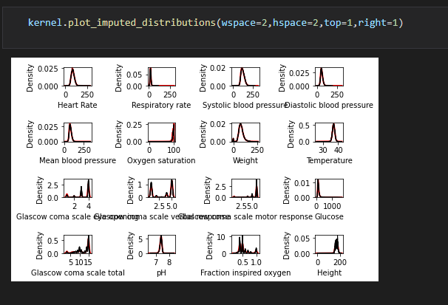
Distribution of imputed-values

Slide 9
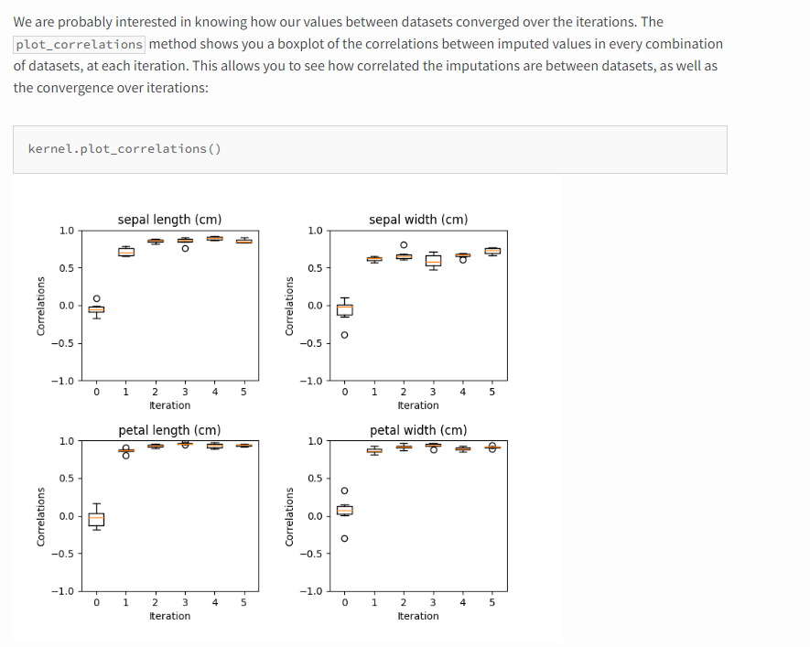
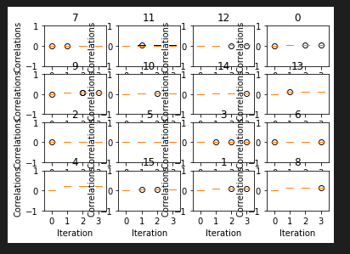
Convergence of Correlation

Slide 10
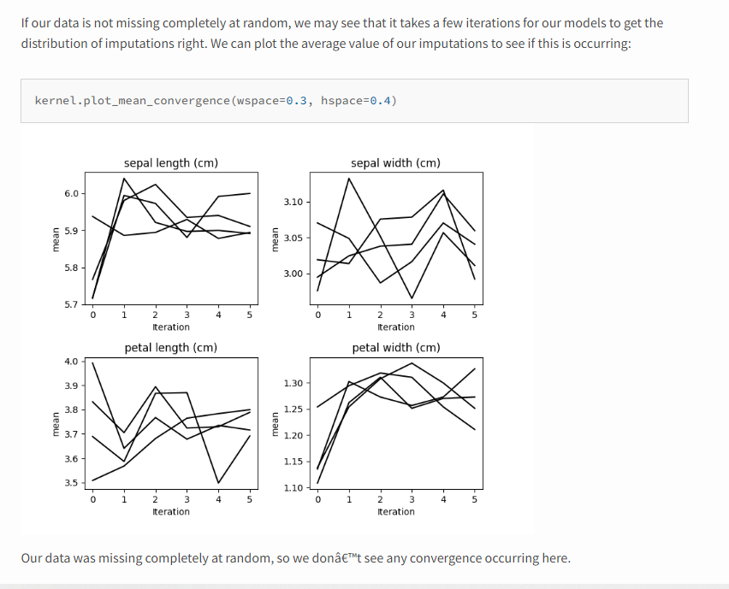
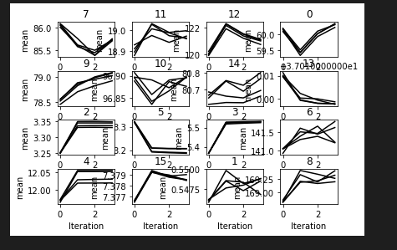
Mean Convergence

Slide 11
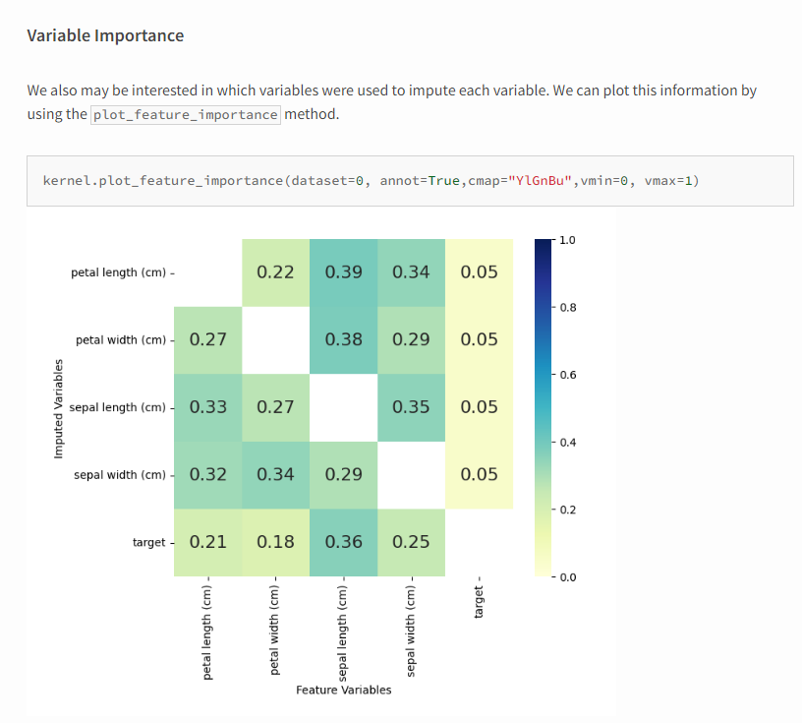
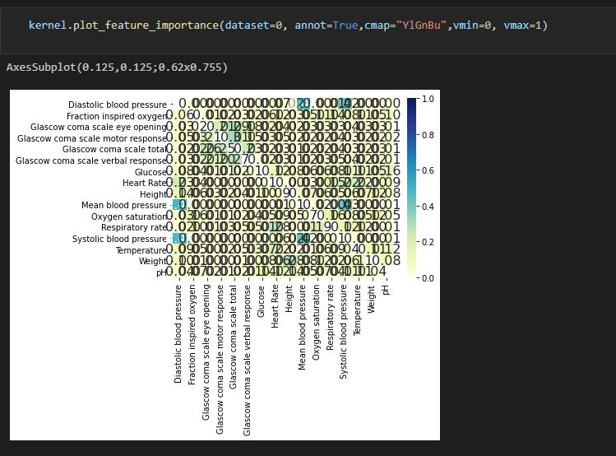
Variable importance

Slide 12
Plan for upcoming weeks
Jan 31- Feb 7: Create comparison metrics pipeline + Optimize models (make changes) + feature selection
Feb 7 – Feb 14: Look at extraction Pipeline + masked data prediction
Finish introduction and background
Feb 14 – Feb 21: Add imputation methods if all models are optimized + Deep learning classification
Finish Analysis/ requirements
Feb 21 – Feb 28: Design, Implementation
Feb 28 – Mar 7: Evaluation, Conclusion
Mar 7 - Mar 14: Complete First Draft 2 weeks before deadline

Slide 13
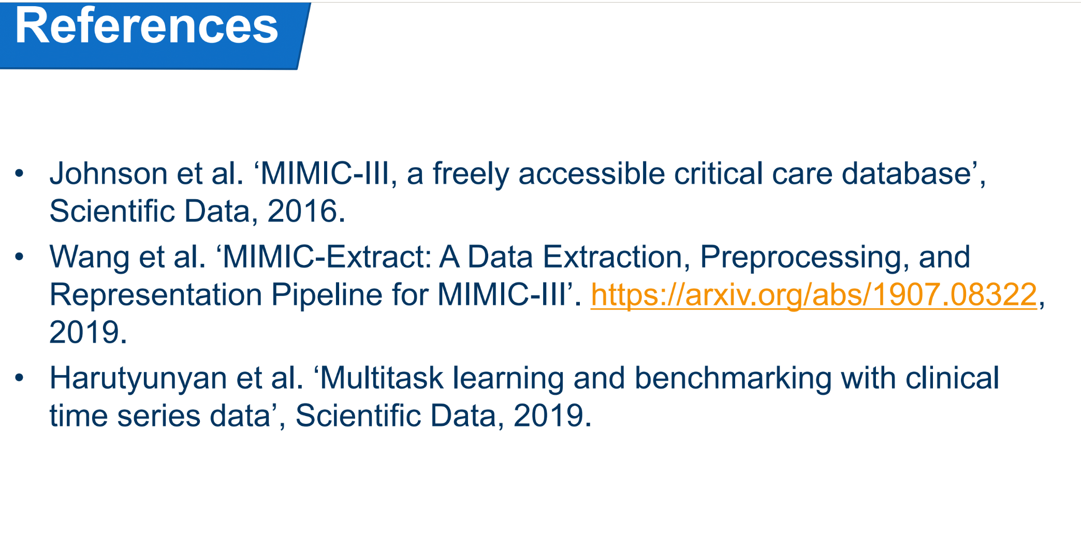
Look at extraction papers
https://arxiv.org/abs/1907.08322
Will fix extraction pipeline when deep learning imputation is done

